Slide 1
Capstone Project-4
NETFLIX MOVIES AND TV SHOWS CLUSTERING Unsupervised ML Individual Capstone Project by Raushan Kumar

Slide 2
Contents
Problem Statement
Dataset Information and Summary
Data Preprocessing & Data Cleaning
Exploratory Data Analysis
Contents Type
Hypothesis Testing
Clustering
Content Based Recommender system
Conclusions

Slide 3
Problem Statement:
This dataset consists of tv shows and movies available on Netflix as of 2019. The dataset is collected from Flixable which is a third-party Netflix search engine.
In 2018, they released an interesting report which shows that the number of TV shows on Netflix has nearly tripled since 2010. The streaming service’s number of movies has decreased by more than 2,000 titles since 2010, while its number of TV shows has nearly tripled. It will be interesting to explore what all other insights can be obtained from the same dataset.
Integrating this dataset with other external datasets such as IMDB ratings, rotten tomatoes can also provide many interesting findings.
In this project, you are required to do
Exploratory Data Analysis
Understanding what type content is available in different countries
Is Netflix has increasingly focusing on TV rather than movies in recent years.
Clustering similar content by matching text-based features

Slide 4
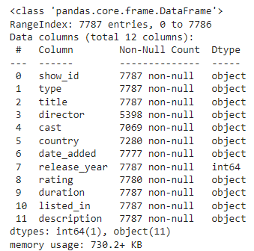
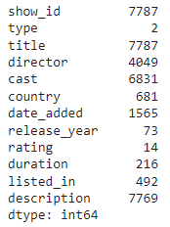

Dataset Information & Summary
The dataset has 7787 observations and 12 features.
There are two type of Show present on the Netflix ➡ 'TV Show' and 'Movie'.
The oldest show present on Netflix has release year of '1925', whereas the latest show has release year of 2021.
The dataset contains two unique type Show as
The dataset contains 14 unique types of Ratings as given below:-

Slide 5
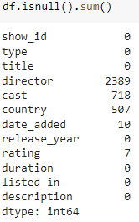
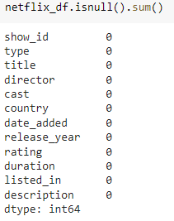
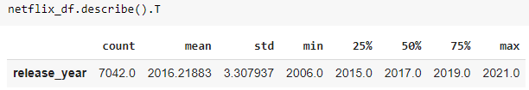
Data Preprocessing & Data Cleaning
There is presence of some missing values in different features(columns), and thus, to make our datasets more lucrative, we must remove any outliers and null values that appear in different rows or columns. The showing DataFrame is df.
All the null value columns were filled with empty string for further analysis except for the country column. As, United States is the top producers of the netflix shows and movies, these empty columns were filled with 'United States' for country. The showing DataFrame is netflix_df.

Slide 6
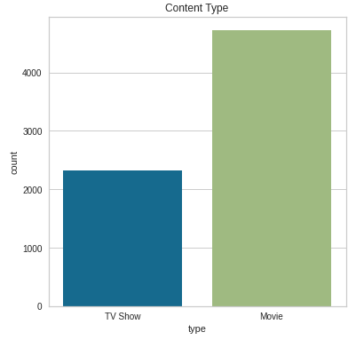
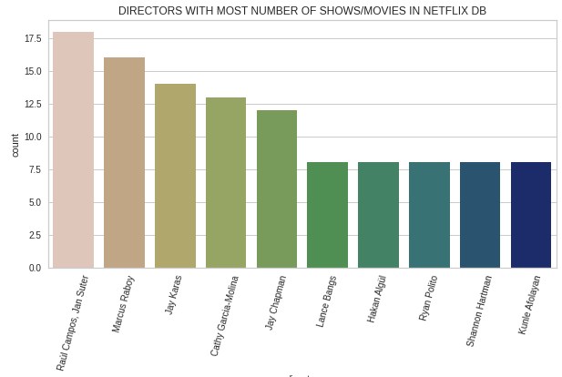
Exploratory Data Analysis
Count Plot to analyze features of the dataframe
Here we observed that Netflix has two types of contents on its portal ➡ 'TV show' and 'Movie', but the number of 'Movie' contents is almost double that of 'TV Show'.
From this plotting, we get that the director with most number of productions in our netflix dataset is 'Raul Campos & Jan suter' followed by 'Marcus Raboy'.

Slide 7
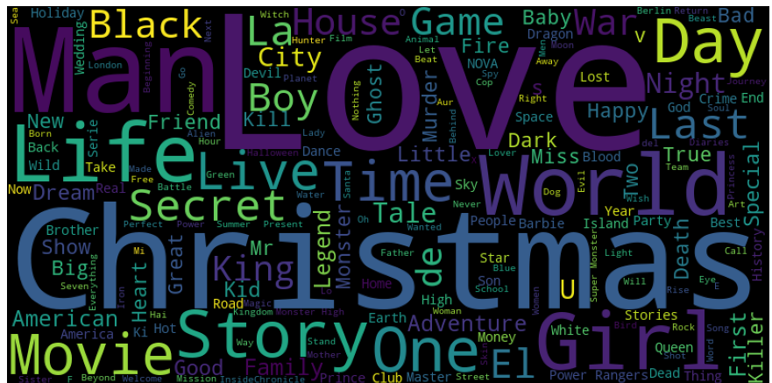
Word Cloud to check the frequency of the genre of the content available in netflix
Here, we observed that Christmas, Love, World, Life, Girl and Man are the most utilized words for movie titles.

Slide 8
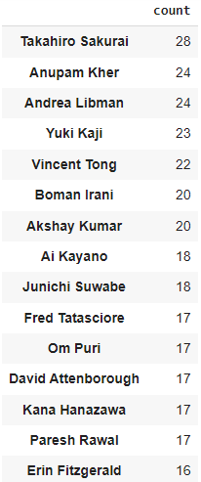
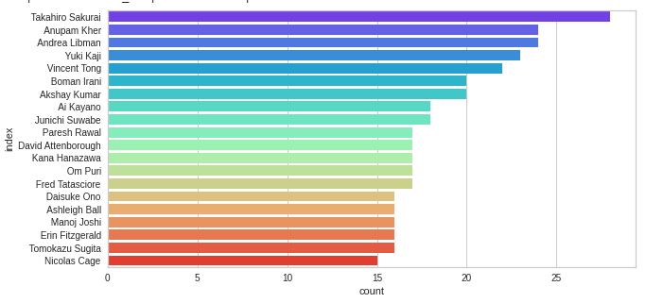
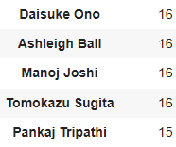
Cast Column
The cast details include the main actors of each movie or TV show.
Here, we observed that Takahiro Sakurai followed by Anupam Kher is the actor with most number of productions with his name on the cast list.

Slide 9
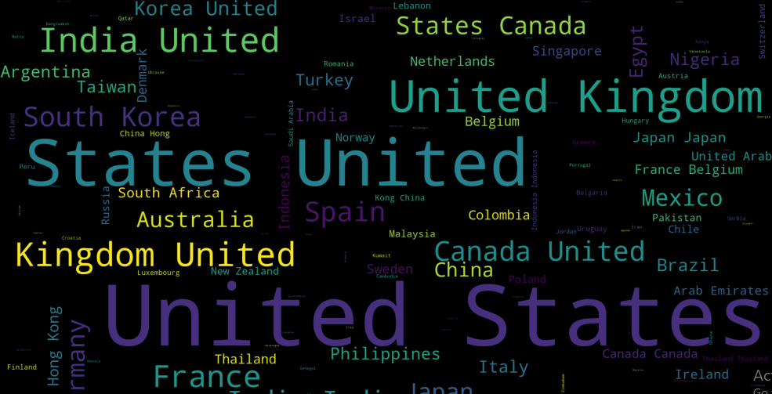
Country
The country with maximum Content is United States, followed by United Kingdom & India.

Slide 10
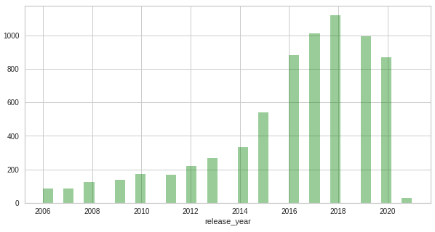
Release Year
Here, we came to know that Netflix database has most of the contents released during the last decade (2010 - 2020 ), also, Netflix contains maximum number of its contents from the release year 2018 followed by 2017 & 2019.

Slide 11
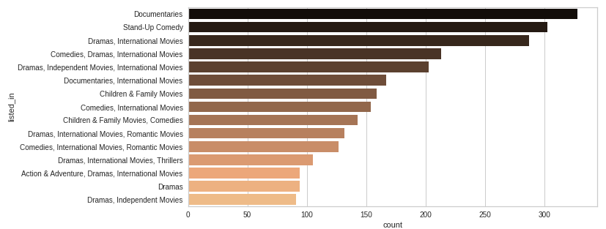
Genres
The most number of Genere listed in Netflix is Documentery, followed by Stand-Up comedy, & Drama, International Movies.

Slide 12
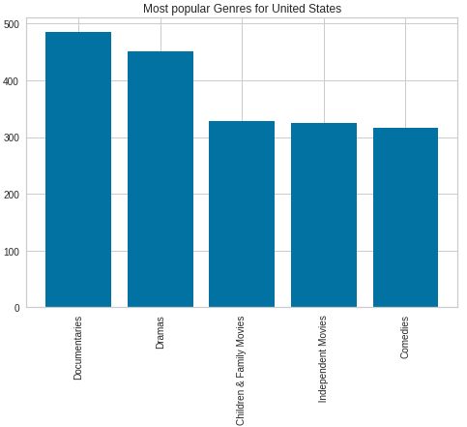
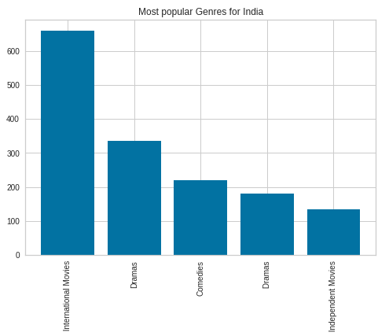
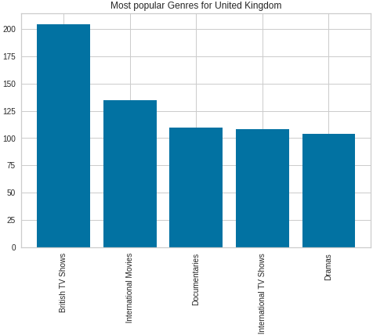
Genres(Contd.)
United States streams mostly
Documentries & Dramas.
India streams streams mostly International movies and Dramas.
United Kingdom streams mostly British TV Shows and International movies.

Slide 13
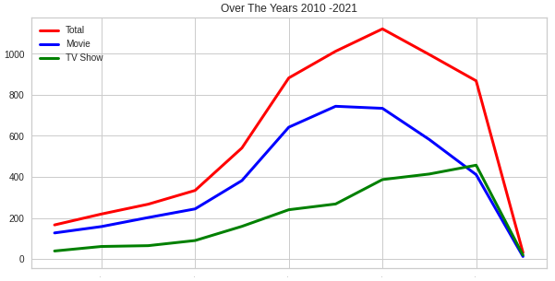
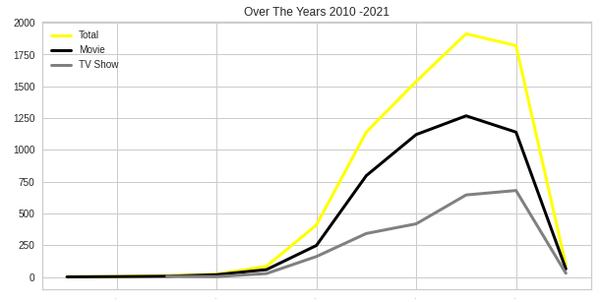
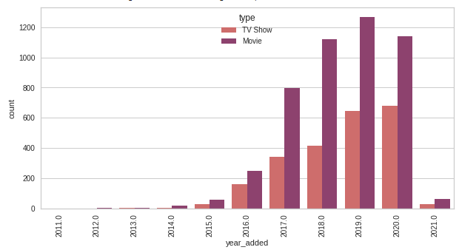
HYPOTHESIS TESTING
This graph is the representation of the movies/shows in the netflix dataset with respect to it released year. This shows the number of netflix production and their year of release. This doesn't explain whether netflix had them when the productions were released. But we can use the year_added column for this information.
We can see that there is a steady decline of production irrespective of the type (movie or show). This could be because the dataset include details of the year 2021 which is the ongoing year. So this year has to be excluded for our testing.
Irrespective of the release years, Netflix has distribution rights for the most number of shows and movies is in the year 2019. Also, there is no decline in the number of movies. Also number if movies added has always been more than the number of tv shows added. Compared the number of tv shows streamed in the year 2010, there is steady increase in the number of tv shows streamed in the year 2019.

Slide 14
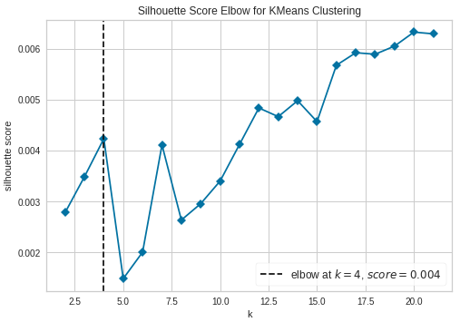
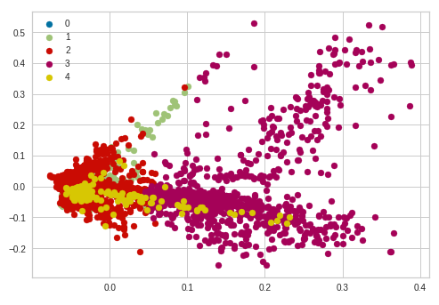
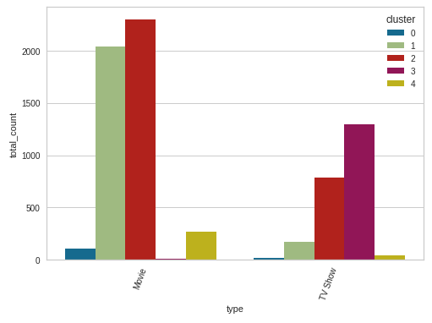
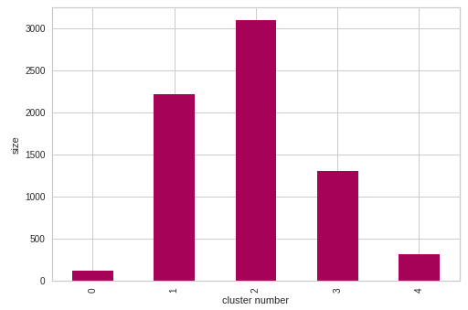
Clustering
K Means Clustering
K-means clustering is a type of unsupervised learning, which is used when you have unlabeled data (i.e., data without defined categories or groups). The goal of this algorithm is to find groups in the data, with the number of groups represented by the variable K.

Slide 15
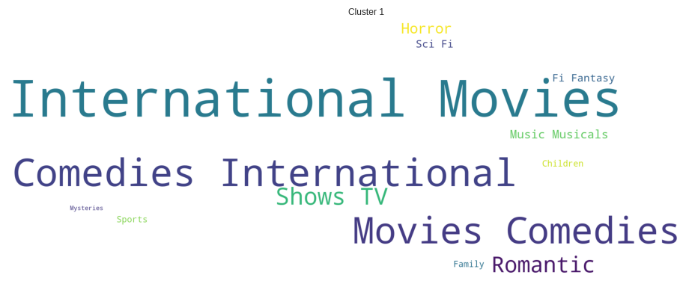
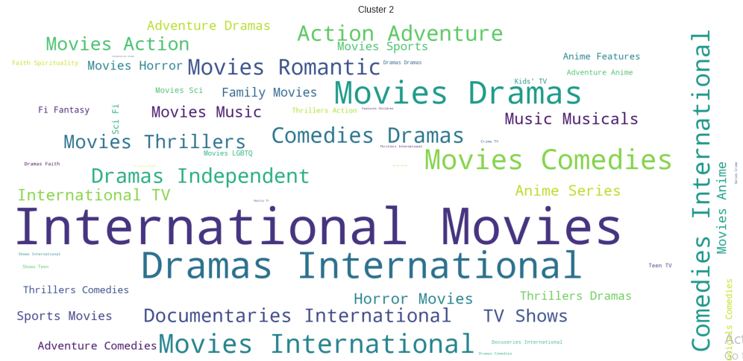


Clustering(Contd.)

Slide 16
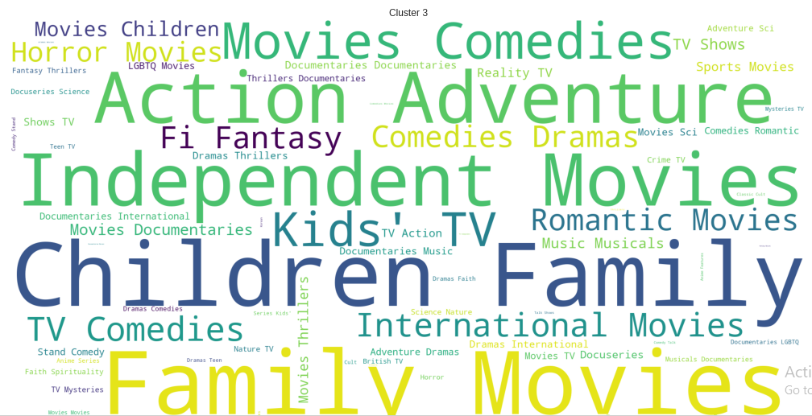

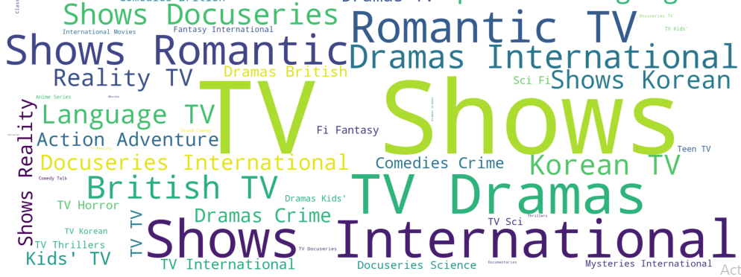
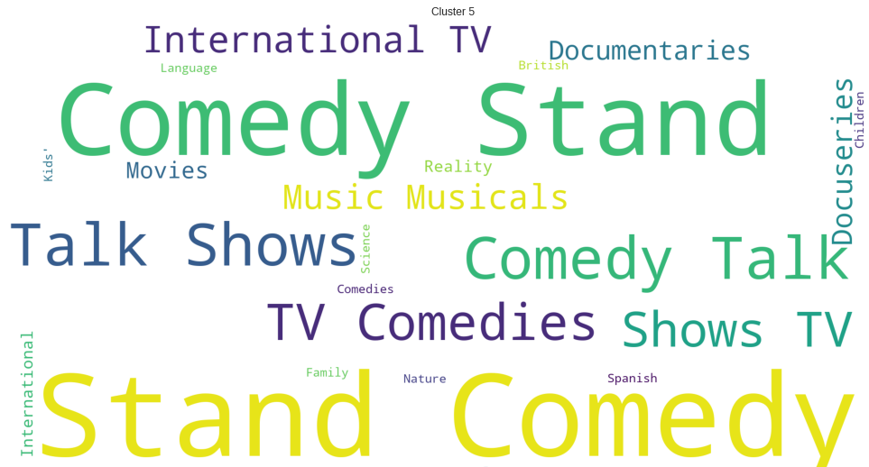



Slide 17

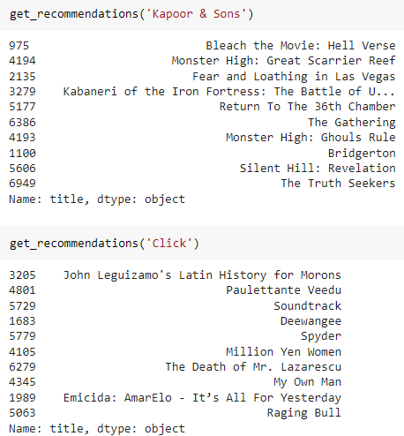
Content Based Recommender system

Slide 18
Conclusions
Netflix has more movies than TV Shows
United States provides the most number of movies and shows followed by India and United Kingdom.
There is an exponential raise in the number of TV shows and movies distributed by Netflix in the recent years.
Text cleaning and vectorization was done on the combined features of the dataset which includes origin country, leading cast member, content type and description for clustering analysis.
Used TF-IDF vectorizer and PCA to preprocess text data before providing to clustering algorithm
Performed K-Means Clustering to create clusters and used silhouette score and elbow curve to find optimal number of clusters
Clusters are identified for each of the record in the dataset.
Recommendation based on cosine similiarity is also done on the same transformed data.

